Slide 1
Is everybody going mad?
Changing definitions
of mental health
Professor Ray Miller

Slide 2
Mental health?
What is mental well-being?
What is mentally healthy?
What is mental distress?
What is a mental disorder?
What is ‘normal’?
What is ‘abnormal’?
What requires treatment?
What requires a different approach?

Slide 3
Scottish Health Surveys
(http://www.scotland.gov.uk/Topics/Statistics/Browse/Health/scottish-health-survey/Publications)
(http://www.scotpho.org.uk/publications/reports-and-papers/887-scotlands-mental-health-adults-2012)

Slide 4
WEMWBS (http://www.healthscotland.com/documents/1467.aspx)

Slide 5
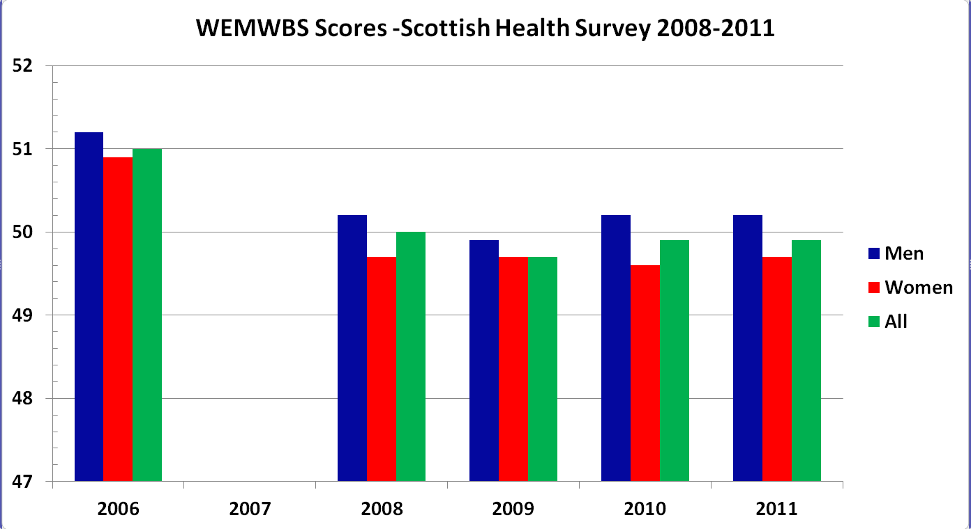
The good news
Well-being: Scores from 14 (poor) to 70 (good)
Mean % Well-being: 2008-2011
Men 64.5%, Women 63.7%, All 64%

Slide 6
Government Target
National Indicator
Increase the average score of adults on the Warwick-Edinburgh Mental Wellbeing Scale by 2011.
(National Performance Framework, 2007)

Slide 7
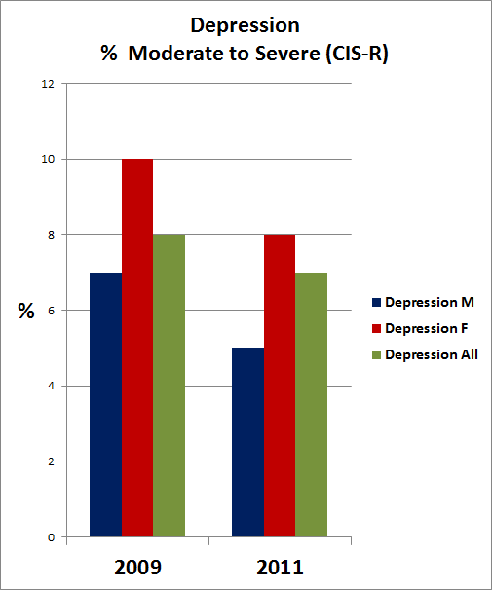
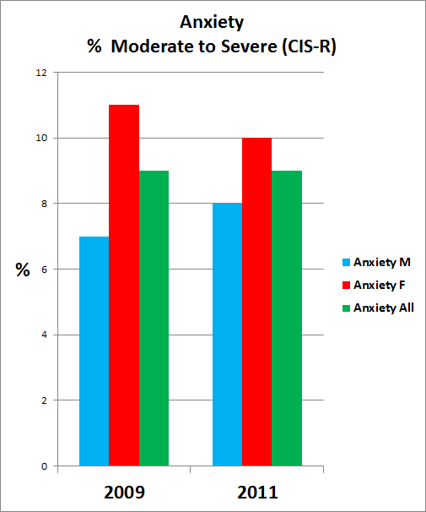
More good news
Depression and Anxiety

Slide 8
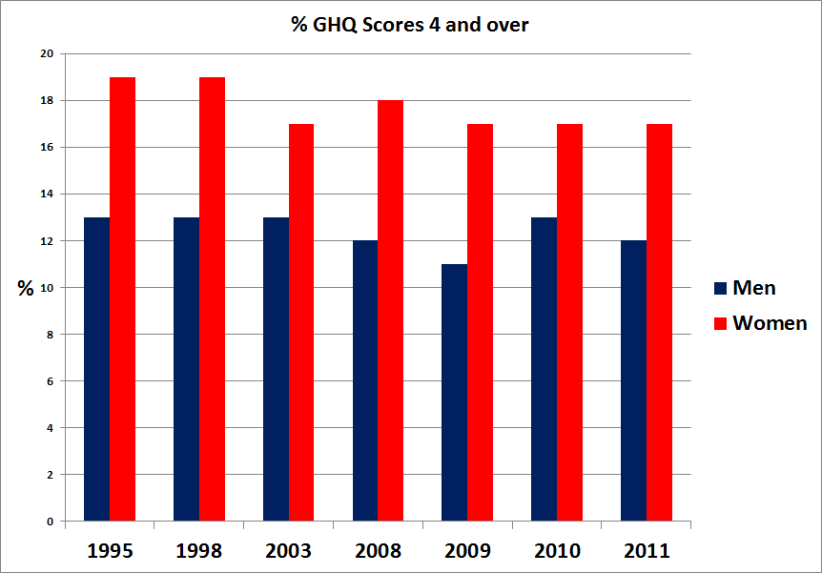
Historically good news
General Health Questionnaire (GHQ-12)

Slide 9
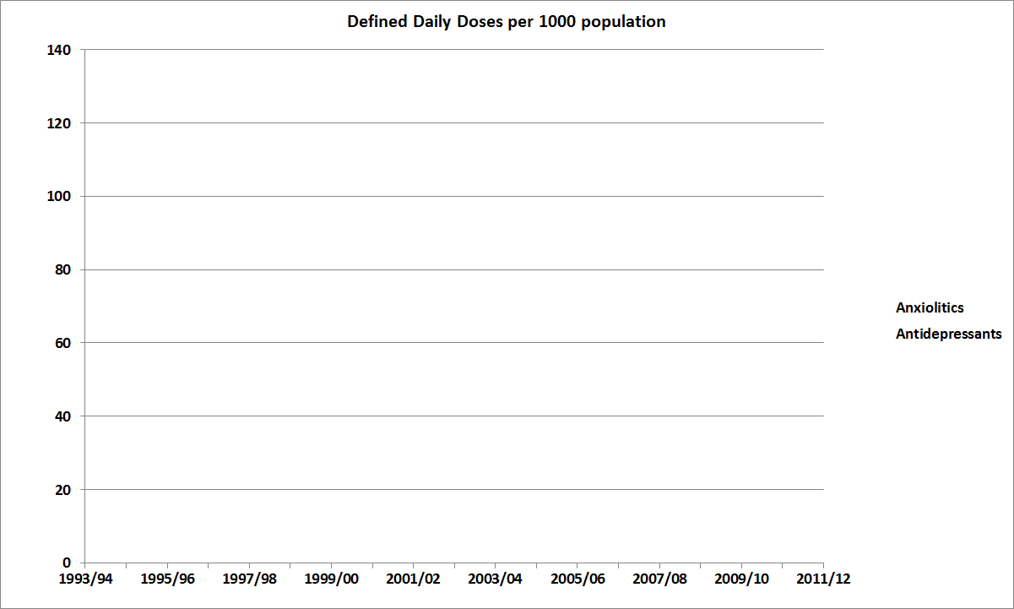
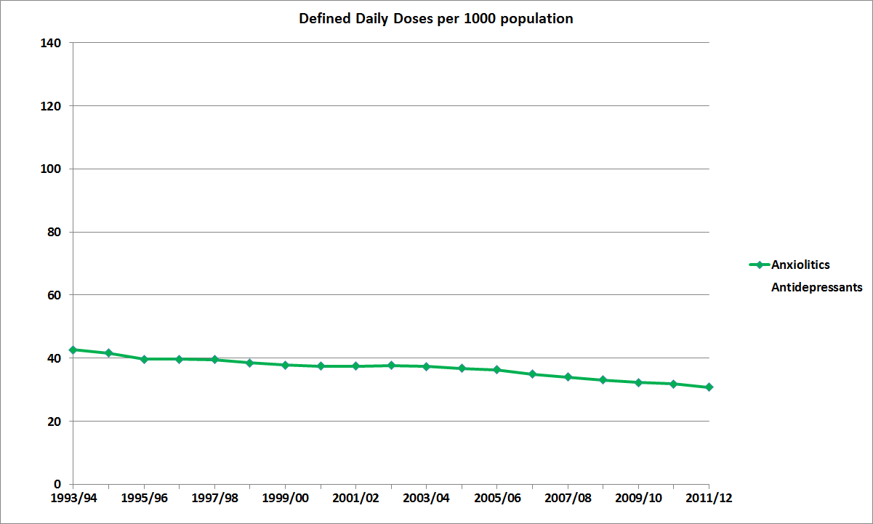
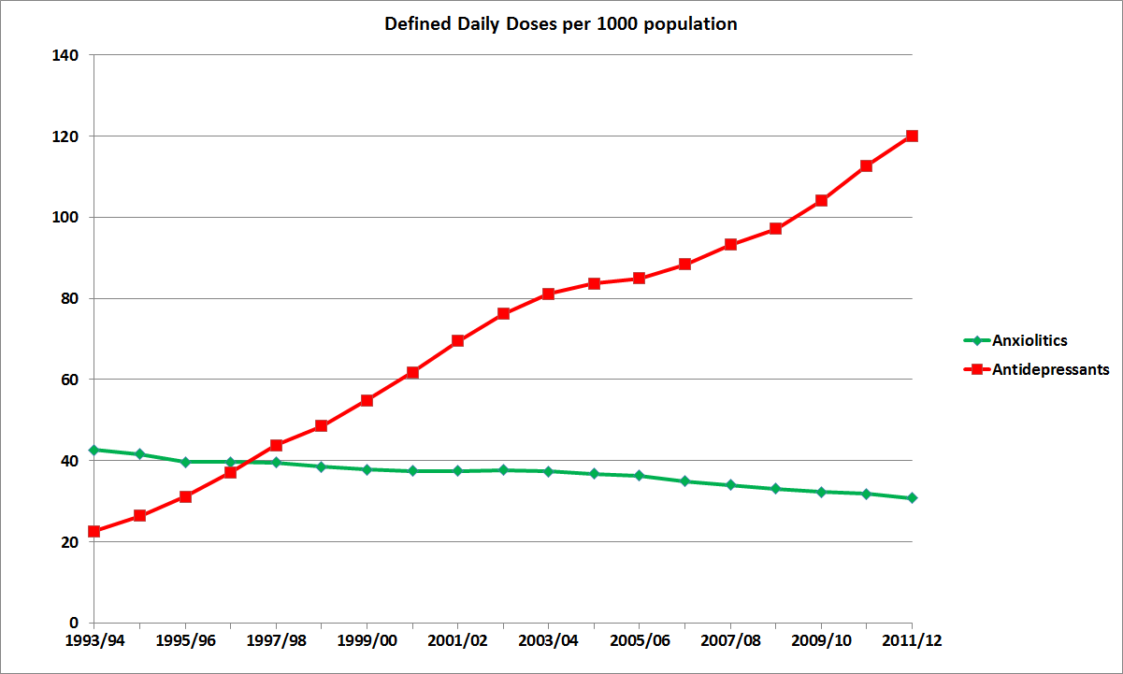
Historical Need (or Demand?)
Prescribed Anxiolitics and Antidepressants

Slide 10
Growing Need (or Demand?) (Scottish Population in 2011 = 5,254,800)
Patients by Gender – Hypnotics and Anxiolytics Financial Year Total Male Female
2009/10 350,377 126,341 224,016
2010/11 358,588 129,294 229,294
2011/12 363,823 131,659 232,164
That’s 1 in 14 of the population!
Patients by Gender – Antidepressants Financial Year Total Male Female 2009/10 633,791 204,119 429,672
2010/11 675,948 219,071 456,877
2011/12 718,330 234,899 483,431
That’s 1 in 7 of the population!
(Prescribing & Medicines: Medicines for Mental Health, A National Statistics Publication for Scotland, Sept 2012)

Slide 11
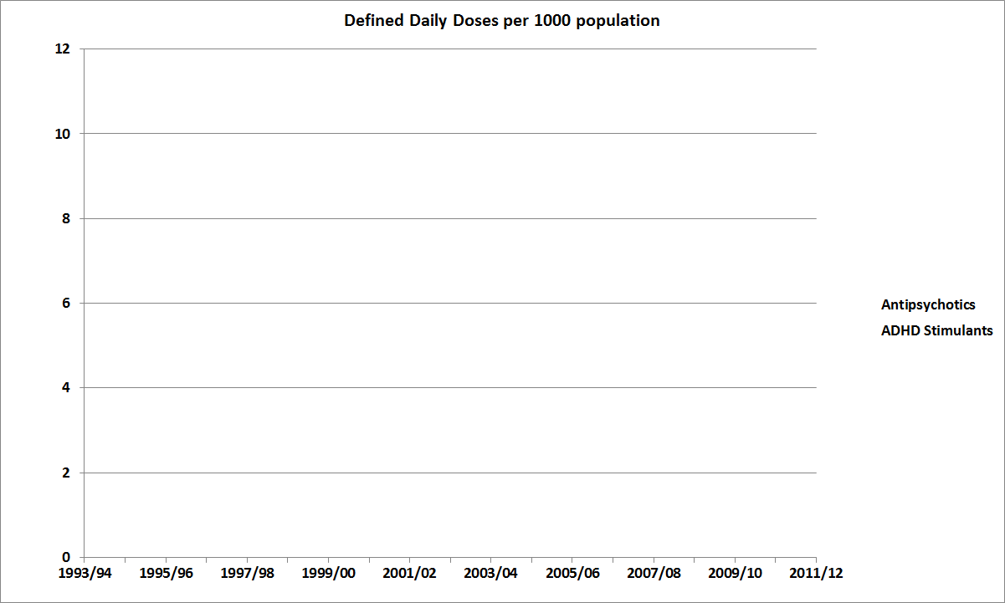
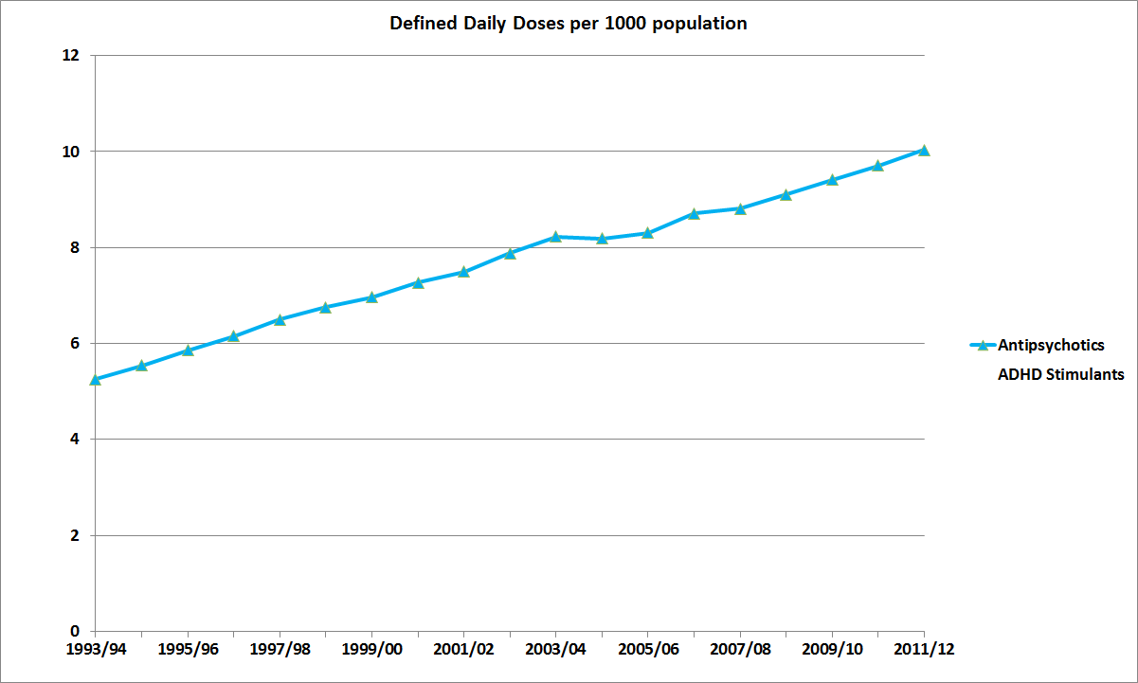
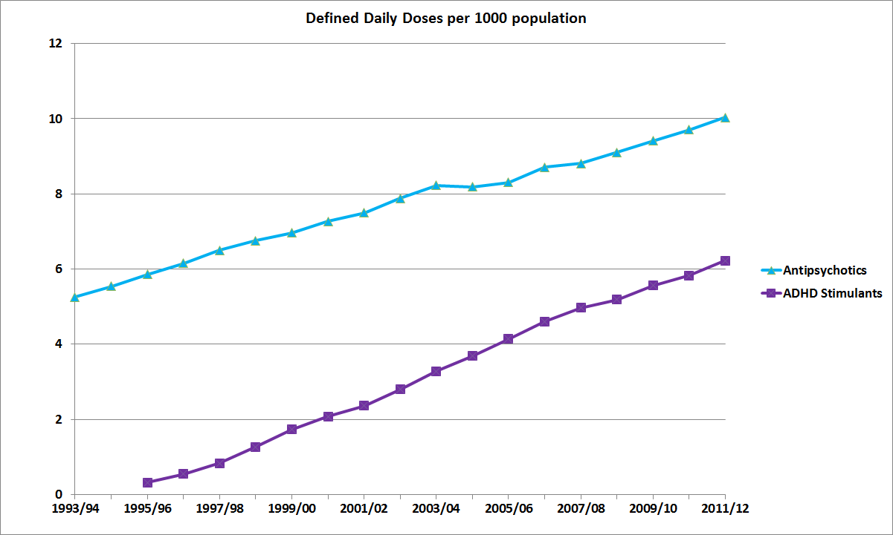
Historical Need (or Demand?)
Prescribed Antipsychotics and ADHD

Slide 12
Growing Need (or Demand?) (Scottish Population in 2011 = 5,254,800)
Patients by Gender – Psychoses and Related Disorders
Financial Year Total Male Female
2009/10 72,811 32,937 39,874
2010/11 75,770 34,513 41,257
2011/12 78,471 35,879 42,592
That’s 1 in 67 of the population!
Patients by Gender – Attention Deficit Hyperactivity Disorder (ADHD) Financial Year Total Male Female
2009/10 6,711 5,500 1,211
2010/11 7,138 5,860 1,278
2011/12 7,511 6,103 1,408
That’s 1 in 700 of the population!
(or 1 in 122 of children under 16!)
(Prescribing & Medicines: Medicines for Mental Health, A National Statistics Publication for Scotland, Sept 2012)

Slide 13
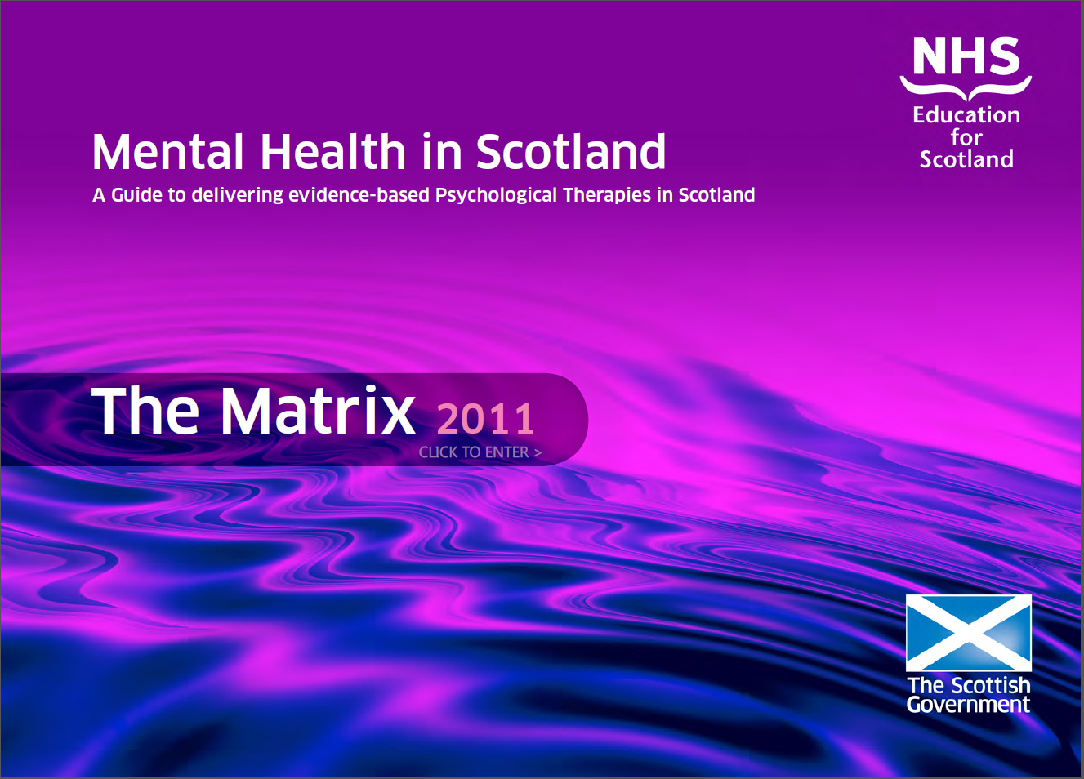
Demand for Psychology
England: “Improving Access to Psychological Therapies”
Scotland: “The Matrix”

Slide 14
Psychologist Numbers (http://www.isdscotland.org/Health-Topics/Workforce/Psychology/)

Slide 15
Europe
Mental illness is one of the top public health challenges in Europe as measured by prevalence, burden of disease and disability.
Across Europe, neuropsychiatric disorders are the second largest contributor to the burden of disease accounting for 19% of the total.
Mental disorders are by far the most significant of the chronic conditions affecting the population of Europe, accounting for just under 40% of all years lived with disability.
The prevalence of mental disorders does not appear to be changing significantly over time, though more people are accessing treatment and support…
(Mental Health Strategy for Scotland: 2012-2015)

Slide 16
Depression and Anxiety
“Common mental health problems refer to those symptoms which can be regarded as extreme forms of ‘normal’ emotional experiences such as depression and anxiety. These problems are common in the population. For example, an estimated 1 in 5 of the population of Scotland will experience depression at some point in their lives and the World Health Organization (WHO) predicts that depression will soon be the second biggest cause of illness worldwide. Those experiencing depression or anxiety often experience physical symptoms.”
(Towards a Mentally Flourishing Scotland, 2009)

Slide 17
Scotland Aims
Commitment 4: We will increase the availability of evidence-based psychological therapies for all age groups in a range of settings and through a range of providers.
Target 1: Reduce the annual rate of increase of defined daily dose per capita of anti-depressants to zero by 2009/10.
(Delivering for Mental Health, 2006)

Slide 18
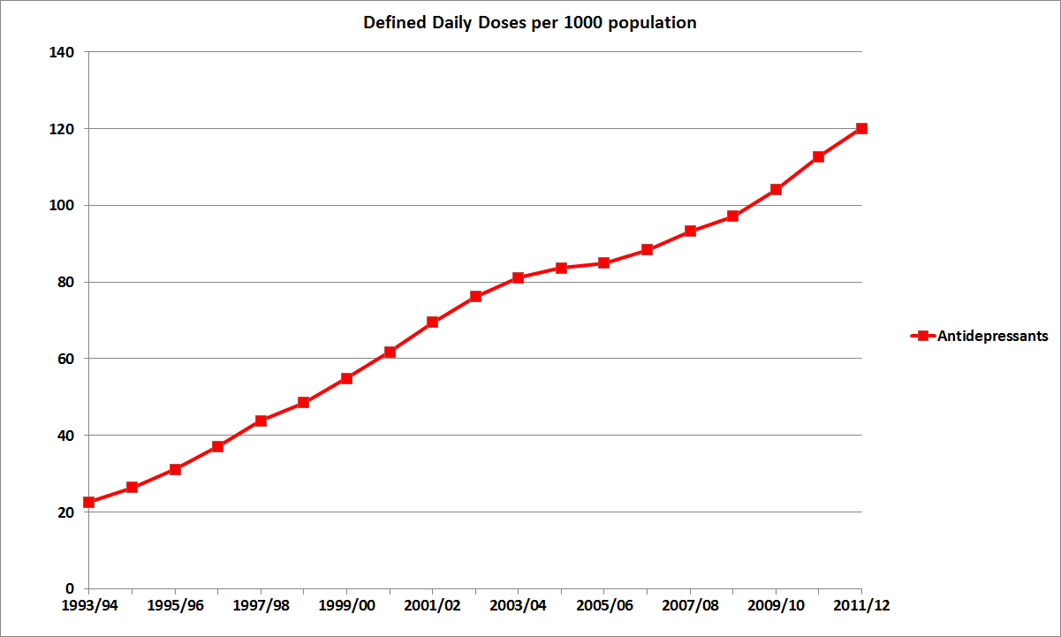
Target met?
Antidepressant prescribing

Slide 19
The Role of Psychology
Commitment 4: We will increase the availability of evidence-based psychological therapies for all age groups in a range of settings and through a range of providers.
(Delivering for Mental Health, 2006)
Commitment 13: We will continue our work to deliver faster access to psychological therapies. By December 2014 the standard for referral to the commencement of treatment will be a maximum of 18 weeks, irrespective of age, illness or therapy.
(Mental Health Strategy for Scotland: 2012-2015)

Slide 20
Is everybody going mad?
“The (dramatic) increase in antidepressant prescribing in Scotland is due to a complex range of linked factors including: success of campaigns to raise awareness of depression; social deprivation and breakdown of traditional social structures; perceived safety of newer antidepressants such as selective serotonin reuptake inhibitors (SSRIs); medicalization of unhappiness driven by drug companies and GPs need ‘to do something’ for patients…”
(Scottish Executive Health Department, Chief Scientist Office, 2007)

Slide 21
Definitions of Deprivation
Material deprivation, which reflects the access people have to material goods and resources. Access to these goods and resources enables people to play the roles, participate in relationships and follow the customary behaviour which is expected of them by virtue of their membership in society.
Social deprivation has been separately distinguished as relating to people’s roles and relationships, membership and social contacts in society.
Multiple deprivation relates to the occurrence of several forms of deprivation concurrently, such as low income, poor housing, and unemployment. This can be particularly stressful for families.

Slide 22
Scottish Index of Multiple Deprivation (SIMD)
Identifies small area concentrations of multiple deprivation across all of Scotland in a consistent way across the following domains:
Income Domain
Employment Domain
Health Domain
Education Domain
Housing Domain
Access Domain
Crime Domain
(http://www.scotland.gov.uk/Topics/Statistics/SIMD)

Slide 23
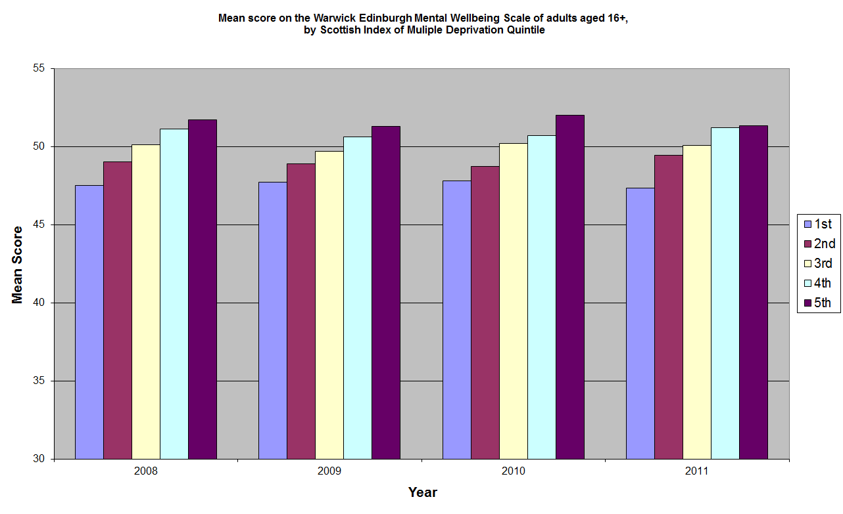
Deprivation?

Slide 24
Medicalization of Distress
Influence of the Diagnostic and Statistical Manual for Mental Disorders (DSM)
Produced by the American Psychiatric Association (APA)
5th Edition due out in May
Criticised for poor evidence basis for diagnoses and strong pressure from health insurance and drug companies (and patients like labels too!)

Slide 25
DSM-V
Previously, a person who had recently lost a loved one and was suffering low moods would be seen as experiencing normal bereavement. DSM-V criteria ignore the death, look only at the symptoms, and diagnose a depressive illness.
Other examples of diagnoses cited by experts as problematic include “premenstrual dysphoric disorder”, “internet addiction disorder” and “mild neurocognitive disorder”
“Oppositional defiant disorder” - a condition in which a child “actively defies or refuses to comply with adults' requests or rules” and “performs deliberate actions to annoy others”.
That basically means children who say 'no' to their parents more than once a week for six months. On that criteria, many of us would have to say our children have a mental disorder.

Slide 26
BPS Objections
A major concern … is that the proposed revisions include lowering diagnostic thresholds across a range of disorders. It is feared that this could lead to medical explanations being applied to normal experiences, and also to the unnecessary use of potentially harmful interventions.
The Society shares concerns about any unsubstantiated shift in emphasis towards biological factors and in particular the entirely unjustified assertion that all mental disorders represent some form of biological dysfunction.

Slide 27
Diminished responsibility?
“GPs need ‘to do something’ for patients”
Increasing expectations of ‘happiness’ as opposed to contentment or well-being
Increasing expectations of entitlement
Increasing reliance on ‘medical’ explanations and interventions
Part of the problem, not the solution
Reduced self reliance and resilience

Slide 28
Other – Self Attributions
Other – if the other person is struggling or failing and engaging in poorly adaptive health, mental health or social behaviours then it is because of basic flaws in their character and personality.
Self – if I am struggling or failing it is because of my poor circumstances, deprived upbringing, genetic deficits, economic disadvantage or just the fact that life is sometimes very unfair.

Slide 29
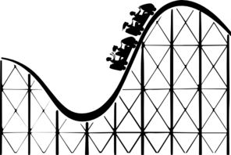
What is normal?
Life doesn’t always go smoothly. There are times when we all have to face difficulties, distress and pain; both physical and emotional. That’s normal.
But as Winston Churchill once said:
“If you are going through Hell, keep going.”
There will be another side where you can come out and move on.
The philosopher Friedrich Nietzsche said:
“That which does not kill us makes us stronger.”
If we learn from our experiences, we come out better able to deal with future problems.
Sometimes adversity is the stimulus for positive change.

Slide 30
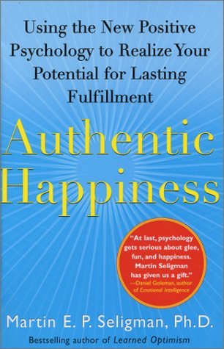
Positive Psychology
Positive psychology is a recent branch of psychology whose purpose was summed up in 1998 by Martin Seligman and Mihaly Csikszentmihalyi:
"We believe that a psychology of positive human functioning will arise, which achieves a scientific understanding and effective interventions to build thriving in individuals, families, and communities.“
(www.authentichappiness.org)
Notes:
Me-high Cheek-sent-me-high

Slide 31
Action for Happiness (http://www.actionforhappiness.org)

Slide 32
(June, 2011)
project. Former BPS President Ray Miller,
for example, said: ‘While everyone seems
to be claiming a right to happiness, I want
to defend the right to be bloody
miserable. If people are seriously led to
believe that happiness is a continuously
attainable state, then they are being
misled. Unhappiness becomes pathology
and people feel cheated and deprived.
They seek a “cure” and believe “someone
should do something” to alleviate their
suffering. But unhappiness is a natural
reaction to some sets of circumstances.
Like a pendulum, we will always swing
between the two states with dynamic
fluctuation only ending when the clock
stops. In a more balanced way, we should
perhaps be aiming for contentment.’

Slide 33
Build on what’s good
Positive Psychology has three central concerns: positive emotions, positive individual traits, and positive institutions.
Positive emotions: contentment with the past, happiness in the present, and hope for the future.
Positive individual traits: strengths and virtues, such as the capacity for love and work, courage, compassion, resilience, creativity, curiosity, integrity, self-knowledge, moderation, self-control, and wisdom.
Positive institutions: strengths that foster better communities, such as justice, responsibility, civility, parenting, nurturance, work ethic, leadership, teamwork, purpose, and tolerance.

Slide 34
Examples of Strengths
Creativity [originality, ingenuity]
Curiosity [interest, novelty-seeking, openness to experience]
Open-mindedness [ judgment, critical thinking]
Love of Learning [education, understanding]
Perspective [wisdom, balance]
Persistence [perseverance, industriousness]
Integrity [authenticity, honesty]
Love [caring, empathy]

Slide 35
Characteristics of Resilience
Emotional Self Control
Strong Relationships
Genuineness and Self Acceptance
Goal Setting
Belief in Self Efficacy
Perspective
Curiosity
Persistence and flexibility
Humour

Slide 36
Well-being dimensions
Hedonic: immediate sense of pleasure
Eudemonic: meaning and purpose
Flow: engagement and absorption
Only Eudemonia and Flow are positively correlated with significant improvements in subjective well-being and reductions in experiences of anxiety and depression.

Slide 37
Well-being questions
The subjective well-being questions in the UK Annual Population Survey ask:
Overall, how satisfied are you with your life nowadays? (Hedonic)
Overall, to what extent do you feel the things you do in your life are worthwhile? (Eudemonic)
Overall, how happy did you feel yesterday? (State)
Overall, how anxious did you feel yesterday? (State)

Slide 38
UK Well-being 2011
Individual well-being measures, United Kingdom
Indicator | Definition | Value (%)
Life satisfaction (Hedonic) | Percentage with medium/ high rating of satisfaction with life overall | 75.9
Worthwhile (Eudemonic) | Percentage with medium/ high rating of how worthwhile the things they do are | 80.0
Happy yesterday (State) | Percentage with medium/ high rating who rated their happiness yesterday | 71.1
Anxious yesterday (State) | Percentage with medium/low rating who rated how anxious they were yesterday | 60.1
Source: Annual Population Survey, Office for National Statistics, Subjective Well-being , April 2011 to March 2012
(http://www.ons.gov.uk/ons/dcp171766_287415.pdf)

Slide 39
Radical change?
From ‘Mental Health’ model of dependence to self-efficacy ‘Mental Fitness’ model
R Realistic expectations
A Accept responsibility
D Develop strengths
I Improve mental fitness
C Challenge and purpose
A Active engagement
L Learn resilience

Slide 40
A new approach?
“The Scottish Government is continuing to take forward work to offer appropriate and timely access to treatment for depression and anxiety and is committed to a range of approaches that meet the different needs of patients, including increased access to psychological therapies, guided self-help, non-pharmacological interventions and prescription of medication. The voluntary sector also offers a range of counselling services to those requiring help with bereavement, trauma, abuse and relationships.”
(Towards a Mentally Flourishing Scotland, 2010)

Slide 41
But Finally…
Are we promoting all psychological distress as ‘abnormal’?
Is this pathologizing everyday life?
Are well-being and resilience health issues or educational and social issues?
What are the consequences of current attitudes?
Are there alternatives?... Or…
Is everybody going mad?

Slide 42
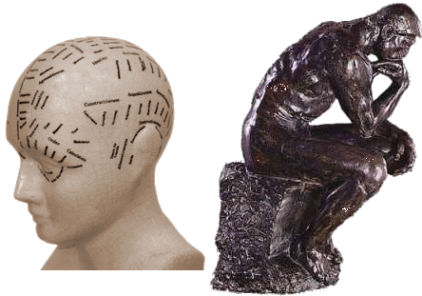
That’s All Folks…
www.Edinburgh-Philosophers.com

